Slide 1


Understanding Youth Substance Use: A Data-Driven Investigation
Machine Learning Analysis of NSDUH Survey Data
by Khaja Moinuddin Mohammed

Slide 2

Introduction to the Study
Study Goals
Dataset Overview
Predictions focus on binary cigarette use, marijuana usage frequency across multiple classes, and estimating the age of first cigarette use with regression.
NSDUH provides over 32,900 youth records with more than 200 variables covering substance use, demographic information, and social environment contexts.
Machine Learning Models
We utilized Decision Tree, Bagging, Random Forest, and Gradient Boosting algorithms to analyze complex patterns in the data.

Slide 3
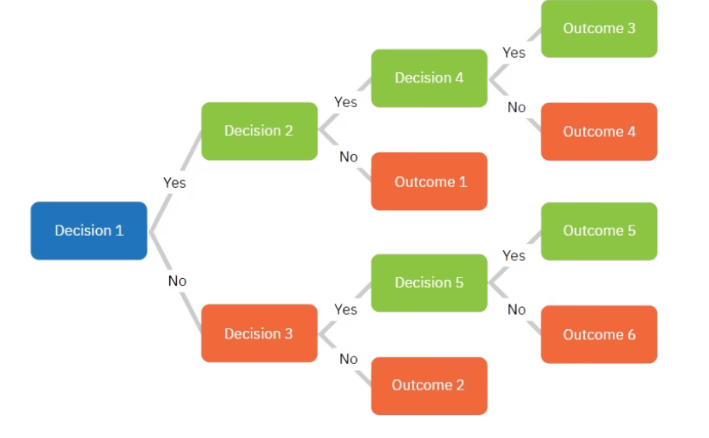
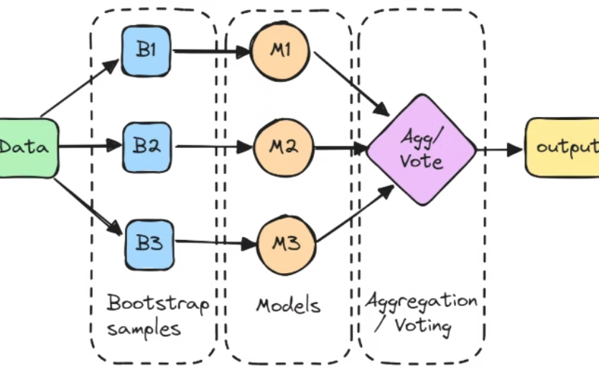
Theoretical Background I: Tree-Based Models
Decision Trees
Bagging
Models that split datasets by feature thresholds to build an interpretable tree structure but prone to overfitting without pruning or depth limits.
An ensemble method training many trees on bootstrapped samples, aggregating outputs to reduce variance and enhance generalization with out-of-bag validation.

Slide 4
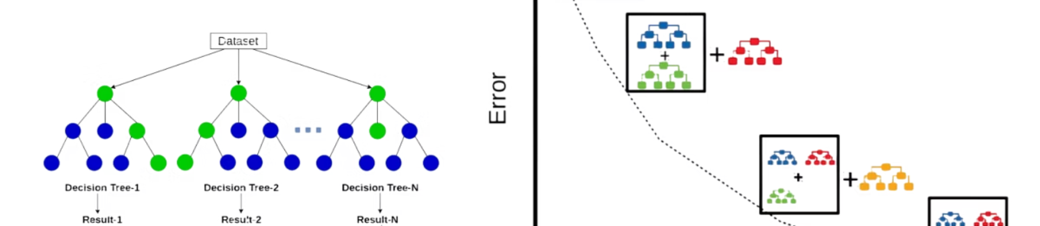
Theoretical Background II: Ensembles & Evaluation
Random Forest
Gradient Boosting
Introduces feature randomness during bagging, enhancing robustness and enabling feature importance assessment.
Sequentially fits trees to residuals, achieving high accuracy but sacrificing interpretability.
Assessment Metrics
Limitations
Classification: Accuracy, Precision, Recall, F1 Score, ROC AUC
Complex ensembles obscure individual decision pathways; challenges include imbalanced classes and survey sample biases that affect prediction validity.
Regression: Root Mean Squared Error (RMSE), R² Score

Slide 5



Methodology I: Data & Feature Engineering
Feature Engineering
Constructed interaction terms (e.g., School_Parental_Interaction), composite variables (e.g., Peer_Influence), and polynomial features (e.g., Income_Squared) to capture complex relationships.
2
Data Cleaning
Special survey codes indicating missing or non-applicable values were replaced with NaN and rows with missing data were dropped for data integrity.
1
Temporal Variables
3
Created features like Years_Since_First_Drink to incorporate timing effects relevant to substance use initiation.

Slide 6
Methodology II: Modeling & Validation
Model Tuning
Handling Imbalanced Classes
Validation Strategy
Project Organization
Hyperparameters like max_depth, number of estimators, and learning rate were optimized through cross-validation to balance bias and variance effectively.
Stratified k-fold cross-validation ensured robust error estimates, maintaining class proportions across folds.
Implemented SMOTE and SMOTENC synthetic over-sampling techniques to address class imbalance, improving model recall and precision.
Structured folders for data, notebooks, scripts, and results facilitated reproducibility and workflow management.

Slide 7
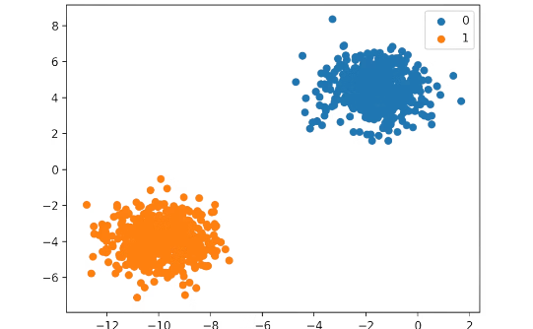
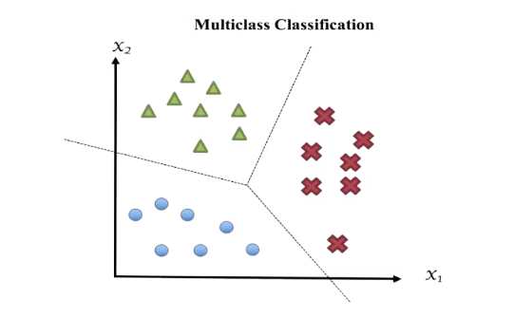
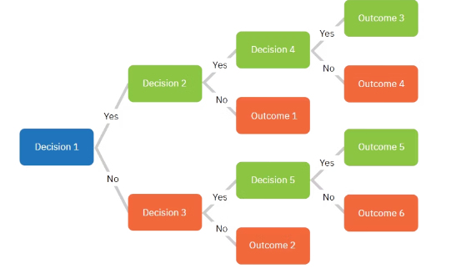
Results: Model Evaluations and Visualizations
Binary Classification
Multi-Class Classification
Decision Tree Visualization
Performance tables demonstrate superior accuracy of ensemble methods. Feature importance plots show peer influence and alcohol use timing as key predictors. Model diagnostics support robust predictive capacity with room for improvement in class imbalance contexts.

Slide 8


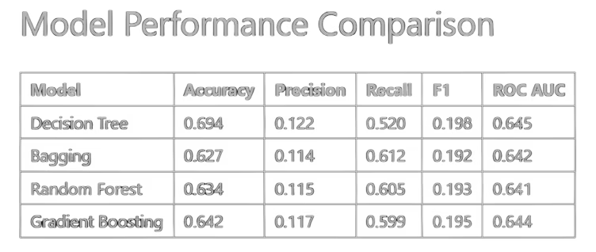
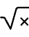
Discussion I: Model Insights and Comparative Analysis
Performance Highlights
Error Trends
All models face challenges with precision due to data imbalance. Gradient Boosting achieves highest multi-class F1 scores but sacrifices interpretability.
Random Forest and Bagging excel in regression and multi-class predictions. Decision Tree offers competitive binary classification accuracy but lacks ensemble robustness.
Explained Variance
Regression models account for up to 46% variance in age of first cigarette use, indicating moderate predictive success.

Slide 9
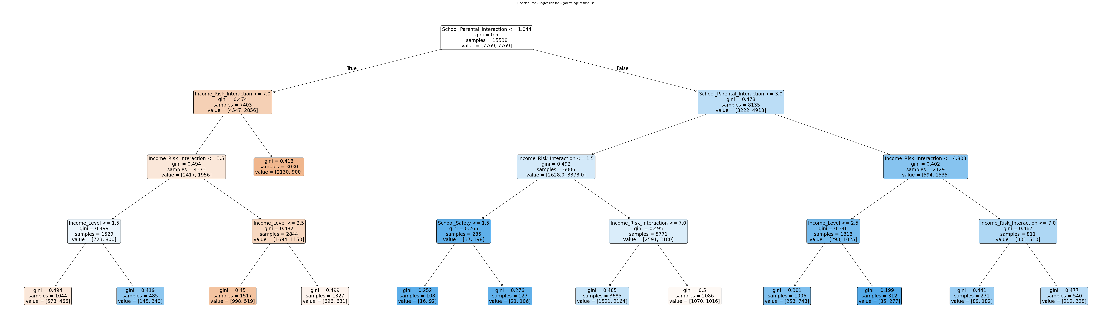

Slide 10



Discussion II: Decision Paths, Variable Types, and Ethical Considerations
Notable Tree Path
Low School_Parental_Interaction → High Income_Risk_Interaction → High Peer_Influence → Elevated probability of youth smoking (7x increase).
Variable Encoding Effects
Binary, ordinal, and numerical encodings influence split granularity and thresholding, enabling nuanced predictive pathways.
Ethical Implications
Focusing on modifiable risks such as family and peer environments promotes targeted prevention without stigmatizing vulnerable youth.

Slide 11

Conclusions and Future Directions
Broader Impacts
Study Limitations
Results can guide school and community interventions focused on early alcohol use and social environment modifications to reduce youth smoking initiation.
Self-report bias, class imbalance, and unmeasured confounders limit predictive performance and generalizability.
Future Work
Enhance models with longitudinal data, richer behavioral/contextual features, and integrate explainable AI methods for transparent decision support.

Slide 12

Thank You

